Slide 1
React/Node.js 101

Slide 2

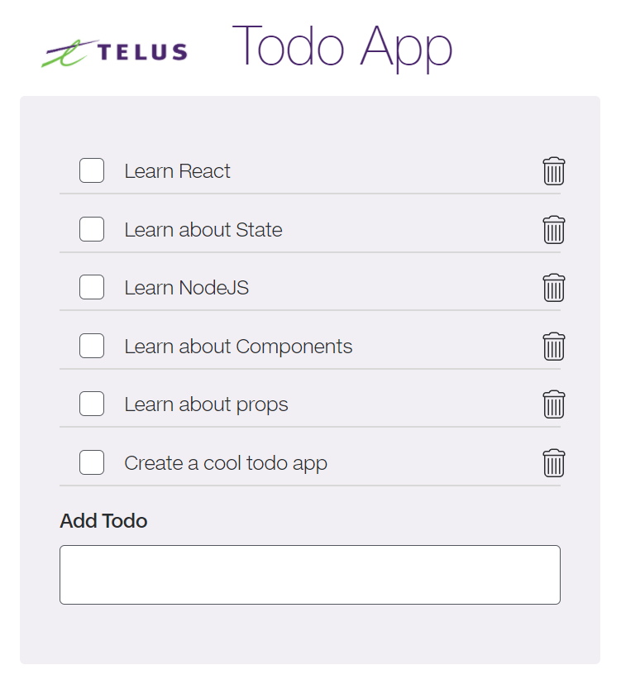
Outcomes
By the end of this workshop, you will:
Learn the fundamentals of React
Learn the fundamentals of Node JS and Express
Create a fully-functioning to-do app

Slide 3

Frontend - React

Slide 4


What is React?
“React is a Javascript Front-end library used for building fast and responsive User Interfaces for web applications”
Uses JSX syntax (yes, it’s okay to mix HTML and JS)
Made up of multiple reusable code blocks called Components
Currently one of the most popular Javascript libraries and has a strong foundation and large community behind it
TELUS Proprietary
Notes:
React -- description
Uses JSX -- It describes what the user interface should look like. By using JSX, you can write HTML structures within the same file that you write Javascript code in.
Simple to read and understand (once you learn the syntax), and avoids use of complex JS DOM structures.

Slide 5
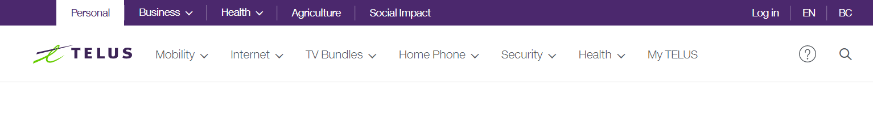
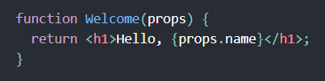
Components
Search
Nav bar
Nav Item
Tooltip
A reusable UI block
UI is made up of multiple components put together
Allows you to think about each piece of the UI in isolation
Essentially a function that returns HTML elements
TELUS Proprietary

Slide 6

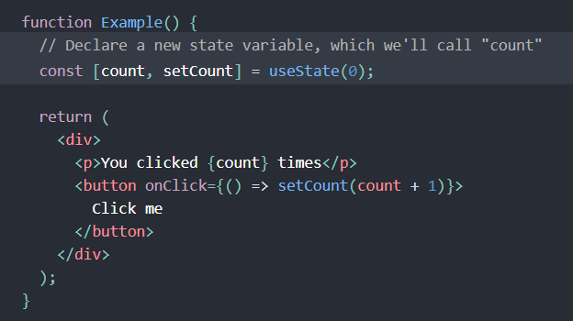
State
Each React component has a built-in state object
State stores properties that belong to the component and affect its appearance
When state changes, the component is re-rendered
TELUS Proprietary

Slide 7
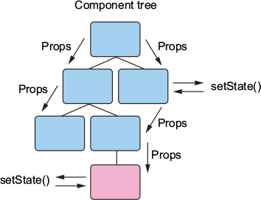
Props
Similar concept to function arguments in plain JS
Passing data between components is done through props
Props are passed one-way - from parent to child components
Props allow you to create generic components that behave differently based on the given props
TELUS Proprietary

Slide 8



Making calls outside our app
We have our React app, but we also want our app to connect to other resources
Common example: a backend server, typically with a database, to store and retrieve data
A commonly used module called ‘axios’ let us make HTTP calls
TELUS Proprietary

Slide 9

Backend - Express / Node JS

Slide 10
What is Node JS?
Simply put, it’s a back-end JavaScript runtime environment that allows JavaScript code to run outside a web browser (e.g. on a computer or Server OS)
By using Node for the back-end server, it lets you use JavaScript across the stack and makes it a lot simpler to build a full app
TELUS Proprietary

Slide 11
HTTP Requests
Our backend application will wait and “listen” for HTTP requests from our client application (frontend React App)
When a request is received, our backend application will figure out what action needs to be taken based on the type of HTTP request it receives, the URL path that it receives it on and data contained in the request body
GET: request data from a resource (e.g. GET /users would return a list of users)
POST: send data to create a resource (e.g. POST /users would create a new user)
PUT: used to send data to update a resource (e.g. PUT /user/id would update a user resource)
DELETE: used to delete a resource (e.g. DELETE /user/id would delete a user resource)
TELUS Proprietary

Slide 12

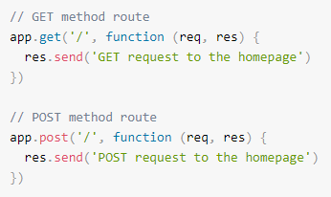
What is Express?
Express is a web framework that makes handling HTTP requests on a Node server much easier
Other examples of web frameworks are Django and Flask used on Python servers
TELUS Proprietary

Slide 13
Todo list
We’ll be applying the fundamental concepts discussed here by writing code to build a functioning todo app that:
Is made up of multiple components, with each maintaining their own state, and passing data via props
Makes HTTP calls to our backend server, which will store, update, delete and retrieve the data based on requests from the frontend
TELUS Proprietary

Slide 14


Let’s get started!
GL HF

Slide 16
Resources
Workshop’s Github Repo: https://github.com/yamenTaha/TELUS_UofT_ReactNode101Workshop
Where to download Node and npm: https://nodejs.org/en/
Node Package registry: https://www.npmjs.com/
Create React App (generates react boilerplate) : https://reactjs.org/docs/create-a-new-react-app.html
Express Generator (generates express boilerplate): https://expressjs.com/en/starter/generator.html
TDS (TELUS style react UI Components): https://tds.telus.com/
Node Official Docs: https://nodejs.org/en/docs/
React Official Docs: https://reactjs.org/docs/getting-started.html
Express Official Docs: https://expressjs.com/
TELUS Proprietary

